Slide 1
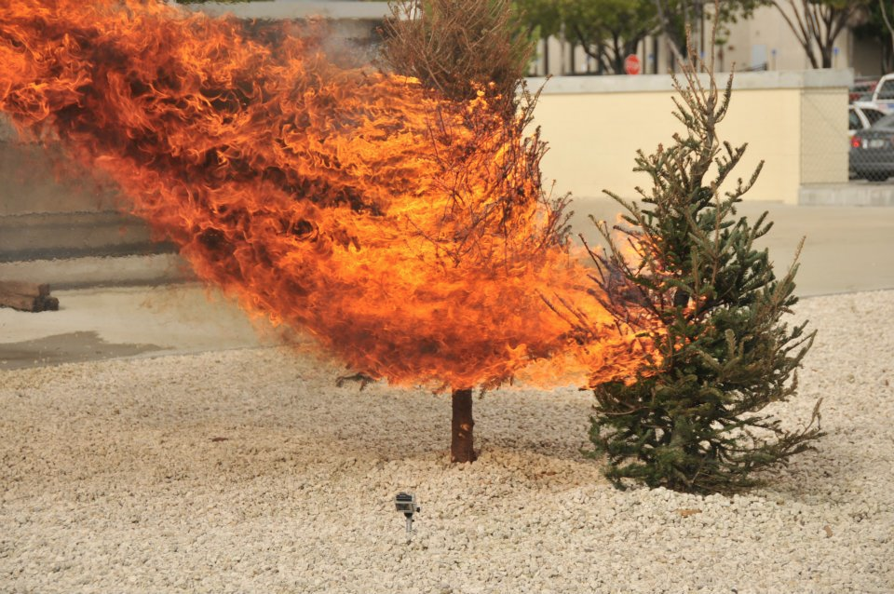
Minimum Spanning Trees
Lecture 25 (Graphs 4)
CS61B, Fall 2023 @ UC Berkeley
Slides credit: Josh Hug
Notes:
Note: For Fall 2023, I've updated all graphs in this lecture so that the nodes are letters (ABCD...), not numbers (0123...), because I think the demos are easier to follow this way.
The web videos still show graphs where the nodes are numbers. If you'd like a version of these slides where the nodes are numbers, refer back to the Spring 2023 slides: Overall lecture, Prim's conceptual, Prim's optimized, Kruskal's basic, Kruskal's optimized
Image citation: http://www.miamidade.gov/fire/library/hotlines/2011-december_files/tree-fire.jpg

Slide 2
Graph Problem Warmup
Graph Problem Warmup
Minimum Spanning Trees
Intro
The Cut Property
Prim’s Algorithm
Basic Prim's (Demo)
Optimized Prim's (Demo)
Prim’s Algorithm Code and Runtime
Kruskal’s Algorithm:
Basic Kruskal’s (Demo)
Optimized Kruskal’s (Demo)
Kruskal's vs. Prim's
Kruskal's Algorithm Code and Runtime
Lecture 25, CS61B, Fall 2023

Slide 3
Warm-up Problem
Given a undirected graph, determine if it contains any cycles.
May use any data structure or algorithm from the course so far.
D
B
G
A
E
C
F

Slide 4
Warm-up Problem
Given a undirected graph, determine if it contains any cycles.
May use any data structure or algorithm from the course so far.
Approach 1: Do DFS from 0 (arbitrary vertex).
Keep going until you see a marked vertex.
Potential danger:
1 looks back at 0 and sees marked.
Solution: Just don’t count the node you came from.
Worst case runtime: O(V + E) -- do study guide problems to reinforce this.
With some cleverness, can give a tighter bound of O(V) (the number of edges we check is at most V, so O(V+E) = O(V))
D
B
G
A
E
C
F

Slide 5
Warm-up Problem
Given a undirected graph, determine if it contains any cycles.
May use any data structure or algorithm from the course so far.
Approach 2: Use a WeightedQuickUnionUF object.
For each edge, check if the two vertices are connected.
If not, union them.
If so, there is a cycle.
Worst case runtime: O(V + E α(V)) if we have path compression.
Here α(V) is the inverse Ackermann function from Disjoint Sets.
With similar reasoning from before, we can reduce to O(V α(V))
D
B
G
A
E
C
F

Slide 6
Minimum Spanning Trees Intro
Graph Problem Warmup
Minimum Spanning Trees
Intro
The Cut Property
Prim’s Algorithm
Basic Prim's (Demo)
Optimized Prim's (Demo)
Prim’s Algorithm Code and Runtime
Kruskal’s Algorithm:
Basic Kruskal’s (Demo)
Optimized Kruskal’s (Demo)
Kruskal's vs. Prim's
Kruskal's Algorithm Code and Runtime
Lecture 25, CS61B, Fall 2023

Slide 7
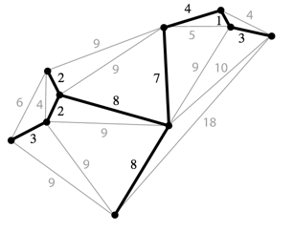
Spanning Trees
Given an undirected graph, a spanning tree T is a subgraph of G, where T:
Is connected.
Is acyclic.
Includes all of the vertices.
Example:
Spanning tree is the black edges and vertices.
These two properties make it a tree.
This makes it spanning.
A minimum spanning tree is a spanning tree of minimum total weight.
Example: Network of power lines that connect a bunch of buildings.

Slide 8
Spanning Trees

Slide 9
Which are Spanning Trees? yellkey.com/TODO
A
B
C
Notes:
https://docs.google.com/forms/d/e/1FAIpQLScXpFsVsC-UkDtTHQZagg977oXNIcVs6EMHn52iA0en3I5aCA/viewform

Slide 10
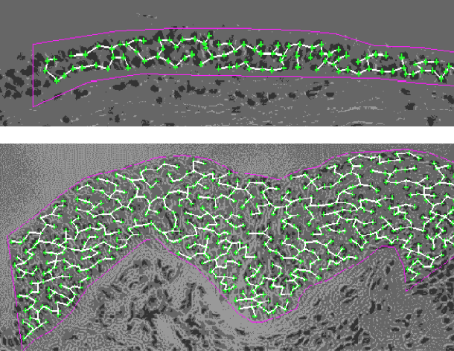
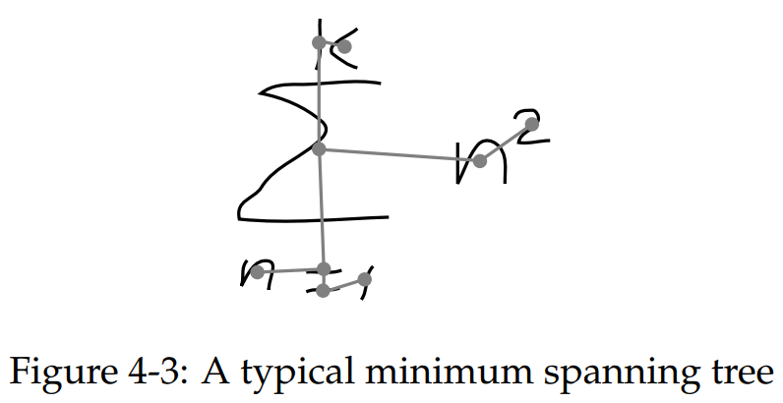
MST Applications
Left: Old school handwriting recognition (link)
Right: Medical imaging (e.g. arrangement of nuclei in cancer cells)
For more, see: http://www.ics.uci.edu/~eppstein/gina/mst.html
Notes:
http://www.bccrc.ca/ci/ta01_archlevel.html

Slide 11
Extra: Minimum Spanning Trees vs. Shortest Paths Trees
These slides are covered in the web videos, but we won't cover them live.
Graph Problem Warmup
Minimum Spanning Trees
Intro
The Cut Property
Prim’s Algorithm
Basic Prim's (Demo)
Optimized Prim's (Demo)
Prim’s Algorithm Code and Runtime
Kruskal’s Algorithm:
Basic Kruskal’s (Demo)
Optimized Kruskal’s (Demo)
Kruskal's vs. Prim's
Kruskal's Algorithm Code and Runtime
Lecture 25, CS61B, Fall 2023

Slide 12
MST
Find the MST for the graph.
B
C
2
2
s
2
A
3
D

Slide 13
MST
Find the MST for the graph.
B
C
2
2
s
2
A
3
D

Slide 14
MST vs. SPT
Is the MST for this graph also a shortest paths tree? If so, using which node as the starting node for this SPT?
A
B
C
D
No SPT is an MST.
B
C
2
2
s
2
A
3
D

Slide 15
MST vs. SPT
Is the MST for this graph also a shortest paths tree? If so, using which node as the starting node for this SPT?
A
B
C
D
No SPT is an MST.
B
C
2
2
2
A
3
D
s = D
Doesn’t work for s = D!

Slide 16
MST vs. SPT, http://yellkey.com/approach
Is the MST for this graph also a shortest paths tree? If so, using which node as the starting node for this SPT?
A
B
C
D
No SPT is an MST.
SPT from A
B
C
2
2
s
2
A
3
D
s
SPT from B,
MST
B
C
2
2
2
A
3
D
s
SPT from C
SPT from D
B
C
2
2
s
s
2
A
3
D

Slide 17
MST vs. SPT, http://yellkey.com/approach
A shortest paths tree depends on the start vertex:
Because it tells you how to get from a source to EVERYTHING.
There is no source for a MST.
Nonetheless, the MST sometimes happens to be an SPT for a specific vertex.

Slide 18
Spanning Tree
Give a valid MST for the graph below.
Hard B level question: Is there a node whose SPT is also the MST?
Yes
No
1
1
1
1
1
1
2
2
0
0
1
2
2
1
1
1
1
1
Notes:
SPLIT INTO TWO PROBLEMS: What is the MST? And is there a node for which it is the SPT?

Slide 19
Spanning Tree
Give a valid MST for the graph below.
Is there a node whose SPT is also the MST? [see next slide]
1
1
1
1
1
1
2
2
0
0
1
2
2
1
1
1
1
1

Slide 20
Spanning Tree
Give a valid MST for the graph below.
Is there a node whose SPT is also the MST?
No! Minimum spanning tree must include only 2 of the 2 weight edges, but the SPT always includes at least 3 of the 2 weight edges.
1
1
1
1
1
1
2
2
0
0
1
2
2
1
1
1
1
1
Example SPT from bottom left vertex:
1
1
1
1
1
1
2
2
0
0
1
2
2
1
1
1
1
1

Slide 21
The Cut Property
Graph Problem Warmup
Minimum Spanning Trees
Intro
The Cut Property
Prim’s Algorithm
Basic Prim's (Demo)
Optimized Prim's (Demo)
Prim’s Algorithm Code and Runtime
Kruskal’s Algorithm:
Basic Kruskal’s (Demo)
Optimized Kruskal’s (Demo)
Kruskal's vs. Prim's
Kruskal's Algorithm Code and Runtime
Lecture 25, CS61B, Fall 2023

Slide 22
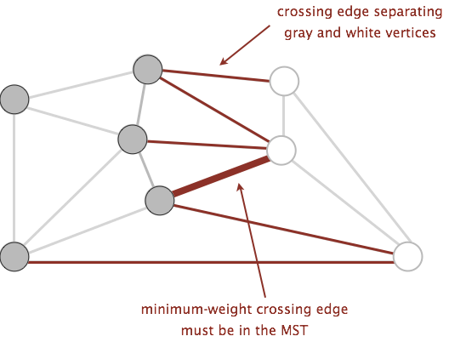
A Useful Tool for Finding the MST: Cut Property
A cut is an assignment of a graph’s nodes to two non-empty sets.
A crossing edge is an edge which connects a node from one set to a node from the other set.
Cut property: Given any cut, minimum weight crossing edge is in the MST.
For rest of today, we’ll assume edge weights are unique.
Notes:
Suppose it were suboptimal.

Slide 23
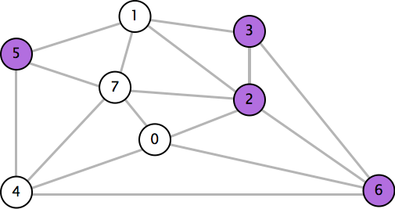
Cut Property in Action: http://yellkey.com/TODO
Which edge is the minimum weight edge crossing the cut {2, 3, 5, 6}?
0-7 0.16
2-3 0.17
1-7 0.19
0-2 0.26
5-7 0.28
1-3 0.29
1-5 0.32
2-7 0.34
4-5 0.35
1-2 0.36
4-7 0.37
0-4 0.38
6-2 0.40
3-6 0.52
6-0 0.58
6-4 0.93
Notes:
https://docs.google.com/forms/d/e/1FAIpQLSc0wZIcQtMCWnBPcl42Vm-rDyirdLm-mhN6WY2oS0F4uRLLXg/viewform

Slide 24
Cut Property in Action
Which edge is the minimum weight edge crossing the cut {2, 3, 5, 6}?
0-2. Must be part of the MST!
0-7 0.16
2-3 0.17
1-7 0.19
0-2 0.26
5-7 0.28
1-3 0.29
1-5 0.32
2-7 0.34
4-5 0.35
1-2 0.36
4-7 0.37
0-4 0.38
6-2 0.40
3-6 0.52
6-0 0.58
6-4 0.93

Slide 25
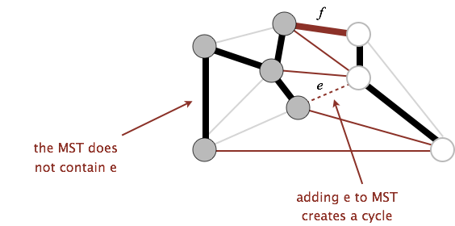
Cut Property Proof
Suppose that the minimum crossing edge e were not in the MST.
Adding e to the MST creates a cycle.
Some other edge f must also be a crossing edge.
Removing f and adding e is a lower weight spanning tree.
Contradiction!

Slide 26
Generic MST Finding Algorithm
Start with no edges in the MST.
Find a cut that has no crossing edges in the MST.
Add smallest crossing edge to the MST.
Repeat until V-1 edges.
This should work, but we need some way of finding a cut with no crossing edges!
Random isn’t a very good idea.

Slide 27
Basic Prim's (Demo)
Graph Problem Warmup
Minimum Spanning Trees
Intro
The Cut Property
Prim’s Algorithm
Basic Prim's (Demo)
Optimized Prim's (Demo)
Prim’s Algorithm Code and Runtime
Kruskal’s Algorithm:
Basic Kruskal’s (Demo)
Optimized Kruskal’s (Demo)
Kruskal's vs. Prim's
Kruskal's Algorithm Code and Runtime
Lecture 25, CS61B, Fall 2023

Slide 28
Prim’s Demo (Conceptual)
Start from some arbitrary start node.
Add shortest edge (mark black) that has one node inside the MST under construction. Repeat until V-1 edges.
D
Node edgeTo
A -
B -
C -
D -
E -
F -
G -
11
B
1
2
2
3
G
5
E
3
s
A
1
1
4
1
C
15
F
Notes:
Note: For Fall 2023, I've updated all graphs in this lecture so that the nodes are letters (ABCD...), not numbers (0123...), because I think the demos are easier to follow this way.
The web videos still show graphs where the nodes are numbers. If you'd like a version of these slides where the nodes are numbers, refer back to the Spring 2023 slides: Prim's conceptual

Slide 29
Prim’s Demo (Conceptual)
Start from some arbitrary start node.
Add shortest edge (mark black) that has one node inside the MST under construction. Repeat until V-1 edges.
D
Node edgeTo
A -
B -
C -
D -
E -
F -
G -
11
B
1
2
2
3
G
5
E
3
s
A
1
1
4
1
C
15
F

Slide 30
Prim’s Demo (Conceptual)
Start from some arbitrary start node.
Add shortest edge (mark black) that has one node inside the MST under construction. Repeat until V-1 edges.
D
Node edgeTo
A -
B -
C A
D -
E -
F -
G -
11
B
1
2
2
3
G
5
E
3
s
A
1
1
4
1
C
15
F

Slide 31
Prim’s Demo (Conceptual)
Start from some arbitrary start node.
Add shortest edge (mark black) that has one node inside the MST under construction. Repeat until V-1 edges.
D
Node edgeTo
A -
B -
C A
D -
E -
F -
G -
11
B
1
2
2
3
G
5
E
3
s
A
1
1
4
1
C
15
F

Slide 32
Prim’s Demo (Conceptual)
Start from some arbitrary start node.
Add shortest edge (mark black) that has one node inside the MST under construction. Repeat until V-1 edges.
D
Node edgeTo
A -
B -
C A
D -
E C
F -
G -
11
B
1
2
2
3
G
5
E
3
s
A
1
1
4
1
C
15
F

Slide 33
Prim’s Demo (Conceptual)
Start from some arbitrary start node.
Add shortest edge (mark black) that has one node inside the MST under construction. Repeat until V-1 edges.
D
Node edgeTo
A -
B -
C A
D -
E C
F -
G -
11
B
1
2
2
3
G
5
E
3
s
A
1
1
4
1
C
15
Which edge is added next?
F
Notes:
Note: The version of this slide on the web videos has the edge between 2 and 5 (with weight 15) in the wrong color.

Slide 34
Prim’s Demo (Conceptual)
Start from some arbitrary start node.
Add shortest edge (mark black) that has one node inside the MST under construction. Repeat until V-1 edges.
D
Node edgeTo
A -
B -
C A
D E
E C
F -
G -
11
B
1
2
2
3
G
5
E
3
s
A
1
1
4
1
C
15
F
Which edge is added next?
Either A-B or D-E are guaranteed to work (see exercises for proof)!
Note: They are not both guaranteed to be in the MST.

Slide 35
Prim’s Demo (Conceptual)
Start from some arbitrary start node.
Add shortest edge (mark black) that has one node inside the MST under construction. Repeat until V-1 edges.
D
Node edgeTo
A -
B -
C A
D E
E C
F -
G -
11
B
1
2
2
3
G
5
E
3
s
A
1
1
4
1
C
15
F

Slide 36
Prim’s Demo (Conceptual)
Start from some arbitrary start node.
Add shortest edge (mark black) that has one node inside the MST under construction. Repeat until V-1 edges.
D
Node edgeTo
A -
B -
C A
D E
E C
F -
G D
11
B
1
2
2
3
G
5
E
3
s
A
1
1
4
1
C
15
F

Slide 37
Prim’s Demo (Conceptual)
Start from some arbitrary start node.
Add shortest edge (mark black) that has one node inside the MST under construction. Repeat until V-1 edges.
D
Node edgeTo
A -
B -
C A
D E
E C
F -
G D
11
B
1
2
2
3
G
5
E
3
s
A
1
1
4
1
C
15
F

Slide 38
Prim’s Demo (Conceptual)
Start from some arbitrary start node.
Add shortest edge (mark black) that has one node inside the MST under construction. Repeat until V-1 edges.
D
Node edgeTo
A -
B -
C A
D E
E C
F G
G D
11
B
1
2
2
3
G
5
E
3
s
A
1
1
4
1
C
15
F

Slide 39
Prim’s Demo (Conceptual)
Start from some arbitrary start node.
Add shortest edge (mark black) that has one node inside the MST under construction. Repeat until V-1 edges.
D
Node edgeTo
A -
B -
C A
D E
E C
F G
G D
11
B
1
2
2
3
G
5
E
3
s
A
1
1
4
1
C
15
F

Slide 40
Prim’s Demo (Conceptual)
Start from some arbitrary start node.
Add shortest edge (mark black) that has one node inside the MST under construction. Repeat until V-1 edges.
D
Node edgeTo
A -
B A
C A
D E
E C
F G
G D
11
B
1
2
2
3
G
5
E
3
s
A
1
1
4
1
C
15
F

Slide 41
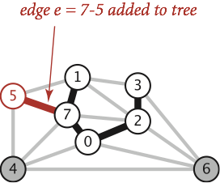
Prim’s Algorithm
Start from some arbitrary start node.
Repeatedly add shortest edge (mark black) that has one node inside the MST under construction.
Repeat until V-1 edges.
Why does Prim’s work? Special case of generic algorithm.
Suppose we add edge e = v->w.
Side 1 of cut is all vertices connected to start, side 2 is all the others.
No crossing edge is black (all connected edges on side 1).
No crossing edge has lower weight (consider in increasing order).

Slide 42
Optimized Prim's (Demo)
Graph Problem Warmup
Minimum Spanning Trees
Intro
The Cut Property
Prim’s Algorithm
Basic Prim's (Demo)
Optimized Prim's (Demo)
Prim’s Algorithm Code and Runtime
Kruskal’s Algorithm:
Basic Kruskal’s (Demo)
Optimized Kruskal’s (Demo)
Kruskal's vs. Prim's
Kruskal's Algorithm Code and Runtime
Lecture 25, CS61B, Fall 2023

Slide 43
Prim’s Algorithm Implementation
The natural implementation of the conceptual version of Prim’s algorithm is highly inefficient.
Example: Iterating over all purple edges shown is unnecessary and slow.
Can use some cleverness and a PQ to speed things up.
Realistic Implementation Demo
Very similar to Dijkstra’s!
D
11
B
1
2
2
3
G
5
E
3
s
A
1
1
4
1
C
15
F

Slide 44
Prim’s Demo
Insert all vertices into fringe PQ, storing vertices in order of distance from tree.
Repeat: Remove (closest) vertex v from PQ, and relax all edges pointing from v.
D
∞
Node distTo edgeTo
A 0 -
B ∞ -
C ∞ -
D ∞ -
E ∞ -
F ∞ -
G ∞ -
∞
11
B
1
2
∞
2
3
∞
0
G
5
E
3
s
A
1
∞
1
4
1
C
∞
15
F
Fringe: [(A: 0), (B: ∞), (C: ∞), (D: ∞), (E: ∞), (F: ∞), (G: ∞)]
Notes:
Note: For Fall 2023, I've updated all graphs in this lecture so that the nodes are letters (ABCD...), not numbers (0123...), because I think the demos are easier to follow this way.
The web videos still show graphs where the nodes are numbers. If you'd like a version of these slides where the nodes are numbers, refer back to the Spring 2023 slides: Prim's optimized

Slide 45
Prim’s Demo
Insert all vertices into fringe PQ, storing vertices in order of distance from tree.
Repeat: Remove (closest) vertex v from PQ, and relax all edges pointing from v.
D
∞
Node distTo edgeTo
A 0 -
B ∞ -
C ∞ -
D ∞ -
E ∞ -
F ∞ -
G ∞ -
∞
11
B
1
2
∞
2
3
∞
0
G
5
E
3
s
A
1
∞
1
4
1
C
∞
15
F
Fringe: [(B: ∞), (C: ∞), (D: ∞), (E: ∞), (F: ∞), (G: ∞)]

Slide 46
Prim’s Demo
Insert all vertices into fringe PQ, storing vertices in order of distance from tree.
Repeat: Remove (closest) vertex v from PQ, and relax all edges pointing from v.
D
2
∞
Node distTo edgeTo
A -
B 2 A
C 1 A
D ∞ -
E ∞ -
F ∞ -
G ∞ -
∞
11
B
1
2
∞
2
3
∞
G
5
E
3
s
A
1
1
∞
1
4
1
C
∞
15
F
Fringe: [(C: 1), (B: 2), (D: ∞), (E: ∞), (F: ∞), (G: ∞)]

Slide 47
Prim’s Demo
Insert all vertices into fringe PQ, storing vertices in order of distance from tree.
Repeat: Remove (closest) vertex v from PQ, and relax all edges pointing from v.
D
∞
Node distTo edgeTo
A 0 -
B 2 A
C 1 A
D ∞ -
E ∞ -
F ∞ -
G ∞ -
2
11
B
1
2
∞
2
3
∞
G
5
E
3
s
A
1
1
1
4
1
C
∞
15
F
Fringe: [(C: 1), (B: 2), (D: ∞), (E: ∞), (F: ∞), (G: ∞)]

Slide 48
Prim’s Demo
Insert all vertices into fringe PQ, storing vertices in order of distance from tree.
Repeat: Remove (closest) vertex v from PQ, and relax all edges pointing from v.
D
∞
Node distTo edgeTo
A -
B 2 A
C A
D ∞ -
E ∞ -
F ∞ -
G ∞ -
2
11
B
1
2
∞
2
3
∞
G
5
E
3
s
A
1
1
4
1
C
∞
Note: Vertex removal in this implementation of Prim’s is equivalent to edge addition in the conceptual version of Prim’s.
15
F
Fringe: [(B: 2), (D: ∞), (E: ∞), (F: ∞), (G: ∞)]

Slide 49
Prim’s Demo
Insert all vertices into fringe PQ, storing vertices in order of distance from tree.
Repeat: Remove (closest) vertex v from PQ, and relax all edges pointing from v.
D
∞
Node distTo edgeTo
A -
B 2 A
C A
D ∞ -
E 1 C
F 15 C
G ∞ -
2
11
B
1
2
1
∞
2
3
∞
G
5
E
3
s
A
1
1
4
1
15
C
∞
15
F
Fringe: [(E: 1), (B: 2), (F: 15), (D: ∞), (G: ∞)]

Slide 50
Prim’s Demo
Insert all vertices into fringe PQ, storing vertices in order of distance from tree.
Repeat: Remove (closest) vertex v from PQ, and relax all edges pointing from v.
D
∞
Node distTo edgeTo
A -
B 2 A
C A
D ∞ -
E 1 C
F 15 C
G ∞ -
2
11
B
1
2
∞
2
3
1
G
5
E
3
s
A
1
1
4
1
C
15
15
F
Fringe: [(E: 1), (B: 2), (F: 15), (D: ∞), (G: ∞)]

Slide 51
Prim’s Demo
Insert all vertices into fringe PQ, storing vertices in order of distance from tree.
Repeat: Remove (closest) vertex v from PQ, and relax all edges pointing from v.
Show distTo, edgeTo, and fringe after next relaxation.
D
∞
Node distTo edgeTo
A -
B 2 A
C A
D ∞ -
E 1 C
F 15 C
G ∞ -
2
11
B
1
2
∞
2
3
1
G
5
E
3
s
A
1
1
4
1
C
15
15
F
Fringe: [(E: 1), (B: 2), (F: 15), (D: ∞), (G: ∞)]

Slide 52
Prim’s Demo
Insert all vertices into fringe PQ, storing vertices in order of distance from tree.
Repeat: Remove (closest) vertex v from PQ, and relax all edges pointing from v.
D
∞
Node distTo edgeTo
A -
B 2 A
C A
D ∞ -
E C
F 15 C
G ∞ -
2
11
B
1
2
∞
2
3
G
5
E
3
s
A
1
1
4
1
C
15
15
F
Fringe: [(B: 2), (F: 15), (D: ∞), (G: ∞)]

Slide 53
Prim’s Demo
Insert all vertices into fringe PQ, storing vertices in order of distance from tree.
Repeat: Remove (closest) vertex v from PQ, and relax all edges pointing from v.
D
∞
Node distTo edgeTo
A -
B 2 A
C A
D 2 E
E C
F 4 E
G 3 E
2
11
2
B
1
2
3
∞
2
3
G
5
E
3
s
A
1
1
4
4
1
C
15
15
F
Fringe: [(B: 2), (D: 2), (G: 3), (F: 4)]

Slide 54
Prim’s Demo
Insert all vertices into fringe PQ, storing vertices in order of distance from tree.
Repeat: Remove (closest) vertex v from PQ, and relax all edges pointing from v.
D
2
Node distTo edgeTo
A -
B 2 A
C A
D 2 E
E C
F 4 E
G 3 E
2
11
B
1
2
3
2
3
G
5
E
3
s
A
1
1
4
1
C
4
15
F
Fringe: [(B: 2), (D: 2), (G: 3), (F: 4)]

Slide 55
Prim’s Demo
Insert all vertices into fringe PQ, storing vertices in order of distance from tree.
Repeat: Remove (closest) vertex v from PQ, and relax all edges pointing from v.
D
2
Node distTo edgeTo
A -
B A
C A
D 2 E
E C
F 4 E
G 3 E
11
B
1
2
3
2
3
G
5
E
3
s
A
1
1
4
1
C
4
15
F
No need to consider edges with weight 5 and 3 since other side is already marked!
Fringe: [(D: 2), (G: 3), (F: 4)]

Slide 56
Prim’s Demo
Insert all vertices into fringe PQ, storing vertices in order of distance from tree.
Repeat: Remove (closest) vertex v from PQ, and relax all edges pointing from v.
D
2
Node distTo edgeTo
A -
B A
C A
D 2 E
E C
F 4 E
G 3 E
11
B
1
2
3
2
3
G
5
E
3
s
A
1
1
4
1
C
4
15
F
Fringe: [(D: 2), (G: 3), (F: 4)]

Slide 57
Prim’s Demo
Insert all vertices into fringe PQ, storing vertices in order of distance from tree.
Repeat: Remove (closest) vertex v from PQ, and relax all edges pointing from v.
D
Node distTo edgeTo
A -
B A
C A
D E
E C
F 4 E
G 3 E
11
B
1
2
3
2
3
G
5
E
3
s
A
1
1
4
1
C
4
15
F
Fringe: [(G: 3), (F: 4)]

Slide 58
Prim’s Demo
Insert all vertices into fringe PQ, storing vertices in order of distance from tree.
Repeat: Remove (closest) vertex v from PQ, and relax all edges pointing from v.
D
Node distTo edgeTo
A -
B A
C A
D E
E C
F 4 E
G 1 D
11
B
1
1
2
3
2
3
G
5
E
3
s
A
1
1
4
1
C
4
15
F
Fringe: [(G: 1), (F: 4)]

Slide 59
Prim’s Demo
Insert all vertices into fringe PQ, storing vertices in order of distance from tree.
Repeat: Remove (closest) vertex v from PQ, and relax all edges pointing from v.
D
Node distTo edgeTo
A -
B A
C A
D E
E C
F 4 E
G 1 D
11
B
1
2
1
2
3
G
5
E
3
s
A
1
1
4
1
C
4
15
F
Fringe: [(G: 1), (F: 4)]

Slide 60
Prim’s Demo
Insert all vertices into fringe PQ, storing vertices in order of distance from tree.
Repeat: Remove (closest) vertex v from PQ, and relax all edges pointing from v.
D
Node distTo edgeTo
A -
B A
C A
D E
E C
F 1 G
G D
11
B
1
2
2
3
G
5
E
3
s
A
1
1
4
1
C
4
15
1
F
Fringe: [(F: 1)]

Slide 61
Prim’s Demo
Insert all vertices into fringe PQ, storing vertices in order of distance from tree.
Repeat: Remove (closest) vertex v from PQ, and relax all edges pointing from v.
D
Node distTo edgeTo
A -
B A
C A
D E
E C
F 1 G
G D
11
B
1
2
2
3
G
5
E
3
s
A
1
1
4
1
C
1
15
F
Fringe: [(F: 1)]

Slide 62
Prim’s Demo
Insert all vertices into fringe PQ, storing vertices in order of distance from tree.
Repeat: Remove (closest) vertex v from PQ, and relax all edges pointing from v.
D
Node distTo edgeTo
A -
B A
C A
D E
E C
F G
G D
11
B
1
2
2
3
G
5
E
3
s
A
1
1
4
1
C
15
F
Fringe: []

Slide 63
Prim’s Algorithm Code and Runtime
Graph Problem Warmup
Minimum Spanning Trees
Intro
The Cut Property
Prim’s Algorithm
Basic Prim's (Demo)
Optimized Prim's (Demo)
Prim’s Algorithm Code and Runtime
Kruskal’s Algorithm:
Basic Kruskal’s (Demo)
Optimized Kruskal’s (Demo)
Kruskal's vs. Prim's
Kruskal's Algorithm Code and Runtime
Lecture 25, CS61B, Fall 2023

Slide 64
Prim’s vs. Dijkstra’s
Prim’s and Dijkstra’s algorithms are exactly the same, except Dijkstra’s considers “distance from the source”, and Prim’s considers “distance from the tree.”
Visit order:
Dijkstra’s algorithm visits vertices in order of distance from the source.
Prim’s algorithm visits vertices in order of distance from the MST under construction.
Relaxation:
Relaxation in Dijkstra’s considers an edge better based on distance to source.
Relaxation in Prim’s considers an edge better based on distance to tree.

Slide 65
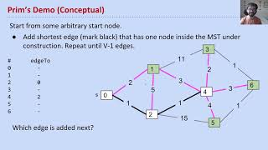
Prim’s vs. Dijkstra’s (visual)
Demos courtesy of Kevin Wayne, Princeton University

Slide 66
Prim’s Implementation (Pseudocode, 1/2)
public class PrimMST {
public PrimMST(EdgeWeightedGraph G) {
edgeTo = new Edge[G.V()];
distTo = new double[G.V()];
marked = new boolean[G.V()];
fringe = new SpecialPQ<Double>(G.V());
distTo[s] = 0.0;
setDistancesToInfinityExceptS(s);
insertAllVertices(fringe);
/* Get vertices in order of distance from tree. */
while (!fringe.isEmpty()) {
int v = fringe.delMin();
scan(G, v);
}
}
...
Fringe is ordered by distTo tree. Must be a specialPQ like Dijkstra’s.
Get vertex closest to tree that is unvisited.
Scan means to consider all of a vertices outgoing edges.

Slide 67
Prim’s Implementation (Pseudocode, 2/2)
while (!fringe.isEmpty()) {
int v = fringe.delMin();
scan(G, v);
}
Important invariant, fringe must be ordered by current best known distance from tree.
private void scan(EdgeWeightedGraph G, int v) {
marked[v] = true;
for (Edge e : G.adj(v)) {
int w = e.other(v);
if (marked[w]) { continue; }
if (e.weight() < distTo[w]) {
distTo[w] = e.weight();
edgeTo[w] = e;
pq.decreasePriority(w, distTo[w]);
}
}
}
Vertex is closest, so add to MST.
Already in MST, so go to next edge.
Better path to a particular vertex found, so update current best known for that vertex.

Slide 68
Prim’s Runtime
What is the runtime of Prim’s algorithm?
Assume all PQ operations take O(log(V)) time.
Give your answer in Big O notation.
while (!fringe.isEmpty()) {
int v = fringe.delMin();
scan(G, v);
}
private void scan(EdgeWeightedGraph G, int v) {
marked[v] = true;
for (Edge e : G.adj(v)) {
int w = e.other(v);
if (marked[w]) { continue; }
if (e.weight() < distTo[w]) {
distTo[w] = e.weight();
edgeTo[w] = e;
pq.decreasePriority(w, distTo[w]);
}
}
}

Slide 69
Prim’s Algorithm Runtime
Priority Queue operation count, assuming binary heap based PQ:
Insertion: V, each costing O(log V) time.
Delete-min: V, each costing O(log V) time.
Decrease priority: O(E), each costing O(log V) time.
Operation not discussed in lecture, but it was in lab 10.
Overall runtime: O(V*log(V) + V*log(V) + E*log(V)).
Assuming E > V, this is just O(E log V) (Same as Dijkstra's).
 | # Operations | Cost per operation | Total cost
PQ add | V | O(log V) | O(V log V)
PQ delMin | V | O(log V) | O(V log V)
PQ decreasePriority | O(E) | O(log V) | O(E log V)

Slide 70
Basic Kruskal’s (Demo)
Graph Problem Warmup
Minimum Spanning Trees
Intro
The Cut Property
Prim’s Algorithm
Basic Prim's (Demo)
Optimized Prim's (Demo)
Prim’s Algorithm Code and Runtime
Kruskal’s Algorithm:
Basic Kruskal’s (Demo)
Optimized Kruskal’s (Demo)
Kruskal's vs. Prim's
Kruskal's Algorithm Code and Runtime
Lecture 25, CS61B, Fall 2023

Slide 71
Kruskal’s Demo
Consider edges in order of increasing weight. Add to MST unless a cycle is created. Repeat until V-1 edges.
A-C 1
C-E 1
D-G 1
F-G 1
A-B 2
E-B 3
D-E 3
G-E 3
E-F 4
B-C 5
B-D 11
C-F 15
D
11
B
1
3
2
3
G
5
E
3
s
A
1
1
4
1
C
15
F
MST: []
Notes:
Note: For Fall 2023, I've updated all graphs in this lecture so that the nodes are letters (ABCD...), not numbers (0123...), because I think the demos are easier to follow this way.
The web videos still show graphs where the nodes are numbers. If you'd like a version of these slides where the nodes are numbers, refer back to the Spring 2023 slides: Kruskal's basic

Slide 72
Kruskal’s Demo
Consider edges in order of increasing weight. Add to MST unless a cycle is created. Repeat until V-1 edges.
A-C 1
C-E 1
D-G 1
F-G 1
A-B 2
E-B 3
D-E 3
G-E 3
E-F 4
B-C 5
B-D 11
C-F 15
D
11
B
1
3
2
3
G
5
E
3
s
A
1
1
4
1
Cycle?
C
15
F
White and green colorings for vertices show cut being implicitly utilized by Kruskal’s algorithm.
MST: []

Slide 73
Kruskal’s Demo
Consider edges in order of increasing weight. Add to MST unless a cycle is created. Repeat until V-1 edges.
A-C 1
C-E 1
D-G 1
F-G 1
A-B 2
E-B 3
D-E 3
G-E 3
E-F 4
B-C 5
B-D 11
C-F 15
D
11
B
1
3
2
3
G
5
E
3
s
A
1
1
4
1
Cycle? No.
C
15
F
MST: [A-C]

Slide 74
Kruskal’s Demo
Consider edges in order of increasing weight. Add to MST unless a cycle is created. Repeat until V-1 edges.
A-C 1
C-E 1
D-G 1
F-G 1
A-B 2
E-B 3
D-E 3
G-E 3
E-F 4
B-C 5
B-D 11
C-F 15
D
11
B
1
3
2
3
G
5
E
3
s
A
1
1
4
1
Cycle? No.
C
15
F
White and green colorings for vertices show cut being implicitly utilized by Kruskal’s algorithm.
MST: [A-C]

Slide 75
Kruskal’s Demo
Consider edges in order of increasing weight. Add to MST unless a cycle is created. Repeat until V-1 edges.
A-C 1
C-E 1
D-G 1
F-G 1
A-B 2
E-B 3
D-E 3
G-E 3
E-F 4
B-C 5
B-D 11
C-F 15
D
11
B
1
3
2
3
G
5
E
3
s
A
1
1
4
1
Cycle? No.
C
15
F
MST: [A-C, C-E]

Slide 76
Kruskal’s Demo
Consider edges in order of increasing weight. Add to MST unless a cycle is created. Repeat until V-1 edges.
A-C 1
C-E 1
D-G 1
F-G 1
A-B 2
E-B 3
D-E 3
G-E 3
E-F 4
B-C 5
B-D 11
C-F 15
D
11
B
1
3
2
3
G
5
E
3
s
A
1
1
4
1
Cycle?
C
15
F
White and green colorings for vertices show cut being implicitly utilized by Kruskal’s algorithm.
MST: [A-C, C-E]

Slide 77
Kruskal’s Demo
Consider edges in order of increasing weight. Add to MST unless a cycle is created. Repeat until V-1 edges.
A-C 1
C-E 1
D-G 1
F-G 1
A-B 2
E-B 3
D-E 3
G-E 3
E-F 4
B-C 5
B-D 11
C-F 15
D
11
B
1
3
2
3
G
5
E
3
s
A
1
1
4
1
Cycle? No.
C
15
F
MST: [A-C, C-E, D-G]

Slide 78
Kruskal’s Demo
Consider edges in order of increasing weight. Add to MST unless a cycle is created. Repeat until V-1 edges.
A-C 1
C-E 1
D-G 1
F-G 1
A-B 2
E-B 3
D-E 3
G-E 3
E-F 4
B-C 5
B-D 11
C-F 15
D
11
B
1
3
2
3
G
5
E
3
s
A
1
1
4
1
Cycle?
C
15
F
White and green colorings for vertices show cut being implicitly utilized by Kruskal’s algorithm.
MST: [A-C, C-E, D-G]

Slide 79
Kruskal’s Demo
Consider edges in order of increasing weight. Add to MST unless a cycle is created. Repeat until V-1 edges.
A-C 1
C-E 1
D-G 1
F-G 1
A-B 2
E-B 3
D-E 3
G-E 3
E-F 4
B-C 5
B-D 11
C-F 15
D
11
B
1
3
2
3
G
5
E
3
s
A
1
1
4
1
Cycle? No.
C
15
F
MST: [A-C, C-E, D-G, F-G]

Slide 80
Kruskal’s Demo
Consider edges in order of increasing weight. Add to MST unless a cycle is created. Repeat until V-1 edges.
A-C 1
C-E 1
D-G 1
F-G 1
A-B 2
E-B 3
D-E 3
G-E 3
E-F 4
B-C 5
B-D 11
C-F 15
D
11
B
1
3
2
3
G
5
E
3
s
A
1
1
4
1
Cycle?
C
15
F
White and green colorings for vertices show cut being implicitly utilized by Kruskal’s algorithm.
MST: [A-C, C-E, D-G, F-G]

Slide 81
Kruskal’s Demo
Consider edges in order of increasing weight. Add to MST unless a cycle is created. Repeat until V-1 edges.
A-C 1
C-E 1
D-G 1
F-G 1
A-B 2
E-B 3
D-E 3
G-E 3
E-F 4
B-C 5
B-D 11
C-F 15
D
11
B
1
3
2
3
G
5
E
3
s
A
1
1
4
1
Cycle? No.
C
15
F
MST: [A-C, C-E, D-G, F-G, A-B]

Slide 82
Kruskal’s Demo
Consider edges in order of increasing weight. Add to MST unless a cycle is created. Repeat until V-1 edges.
A-C 1
C-E 1
D-G 1
F-G 1
A-B 2
E-B 3
D-E 3
G-E 3
E-F 4
B-C 5
B-D 11
C-F 15
D
11
B
1
3
2
3
G
5
E
3
s
A
1
1
4
1
Cycle?
C
15
F
White and green colorings for vertices show cut being implicitly utilized by Kruskal’s algorithm.
MST: [A-C, C-E, D-G, F-G, A-B]

Slide 83
Kruskal’s Demo
Consider edges in order of increasing weight. Add to MST unless a cycle is created. Repeat until V-1 edges.
A-C 1
C-E 1
D-G 1
F-G 1
A-B 2
E-B 3
D-E 3
G-E 3
E-F 4
B-C 5
B-D 11
C-F 15
D
11
B
1
3
2
3
G
5
E
3
s
A
1
1
4
1
Cycle? Yes. Reject!
C
15
F
MST: [A-C, C-E, D-G, F-G, A-B]

Slide 84
Kruskal’s Demo
Consider edges in order of increasing weight. Add to MST unless a cycle is created. Repeat until V-1 edges.
A-C 1
C-E 1
D-G 1
F-G 1
A-B 2
E-B 3
D-E 3
G-E 3
E-F 4
B-C 5
B-D 11
C-F 15
D
11
B
1
3
2
3
G
5
E
3
s
A
1
1
4
1
Cycle?
C
15
F
White and green colorings for vertices show cut being implicitly utilized by Kruskal’s algorithm.
MST: [A-C, C-E, D-G, F-G, A-B]

Slide 85
Kruskal’s Demo
Consider edges in order of increasing weight. Add to MST unless a cycle is created. Repeat until V-1 edges.
A-C 1
C-E 1
D-G 1
F-G 1
A-B 2
E-B 3
D-E 3
G-E 3
E-F 4
B-C 5
B-D 11
C-F 15
D
11
B
1
3
2
3
G
5
E
3
s
A
1
1
4
1
Cycle? No.
V-1 edges, so we’re done!
C
15
F
MST: [A-C, C-E, D-G, F-G, A-B, D-E]

Slide 86
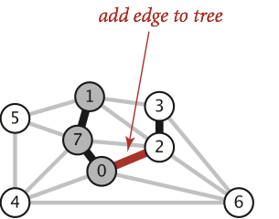
Kruskal’s Algorithm
Initially mark all edges gray.
Consider edges in increasing order of weight.
Add edge to MST (mark black) unless doing so creates a cycle.
Repeat until V-1 edges.
Why does Kruskal’s work? Special case of generic MST algorithm.
Suppose we add edge e = v->w.
Side 1 of cut is all vertices connected to v, side 2 is everything else.
No crossing edge is black (since we don’t allow cycles).
No crossing edge has lower weight (consider in increasing order).

Slide 87
Optimized Kruskal’s (Demo)
Graph Problem Warmup
Minimum Spanning Trees
Intro
The Cut Property
Prim’s Algorithm
Basic Prim's (Demo)
Optimized Prim's (Demo)
Prim’s Algorithm Code and Runtime
Kruskal’s Algorithm:
Basic Kruskal’s (Demo)
Optimized Kruskal’s (Demo)
Kruskal's vs. Prim's
Kruskal's Algorithm Code and Runtime
Lecture 25, CS61B, Fall 2023

Slide 88
Kruskal’s Demo
Insert all edges into PQ.
Repeat: Remove smallest weight edge. Add to MST if no cycle created.
Fringe: (A-C: 1), (C-E: 1),
(D-G: 1), (F-G: 1),
(A-B: 2), (E-B: 3),
(D-E: 3), (G-E: 3),
(E-F: 4), (B-C: 5),
(B-D: 11), (C-F: 15)
D
11
B
1
3
2
3
G
5
E
3
s
A
1
1
4
1
C
15
F
WQU: []
MST: []
Notes:
Note: For Fall 2023, I've updated all graphs in this lecture so that the nodes are letters (ABCD...), not numbers (0123...), because I think the demos are easier to follow this way.
The web videos still show graphs where the nodes are numbers. If you'd like a version of these slides where the nodes are numbers, refer back to the Spring 2023 slides: Kruskal's optimized

Slide 89
Kruskal’s Demo
Insert all edges into PQ.
Repeat: Remove smallest weight edge. Add to MST if no cycle created.
Fringe: (A-C: 1), (C-E: 1),
(D-G: 1), (F-G: 1),
(A-B: 2), (E-B: 3),
(D-E: 3), (G-E: 3),
(E-F: 4), (B-C: 5),
(B-D: 11), (C-F: 15)
D
11
B
1
3
2
3
G
5
E
3
s
A
Removed edge: A-C
1
1
4
1
Cycle? isConnected(A, C)
C
15
F
WQU: []
MST: []

Slide 90
Kruskal’s Demo
Insert all edges into PQ.
Repeat: Remove smallest weight edge. Add to MST if no cycle created.
Fringe: (A-C: 1), (C-E: 1),
(D-G: 1), (F-G: 1),
(A-B: 2), (E-B: 3),
(D-E: 3), (G-E: 3),
(E-F: 4), (B-C: 5),
(B-D: 11), (C-F: 15)
D
11
B
1
3
2
3
G
5
E
3
s
A
Removed edge: A-C
1
1
4
1
Cycle? No. union(A, C). add(A-C).
C
15
F
WQU: [A-C]
MST: [A-C]

Slide 91
Kruskal’s Demo
Insert all edges into PQ.
Repeat: Remove smallest weight edge. Add to MST if no cycle created.
Fringe: (A-C: 1), (C-E: 1),
(D-G: 1), (F-G: 1),
(A-B: 2), (E-B: 3),
(D-E: 3), (G-E: 3),
(E-F: 4), (B-C: 5),
(B-D: 11), (C-F: 15)
D
11
B
1
3
2
3
G
5
E
3
s
A
Removed edge: C-E
1
1
4
1
Cycle? isConnected(C, E)
C
15
F
WQU: [A-C]
MST: [A-C]

Slide 92
Kruskal’s Demo
Insert all edges into PQ.
Repeat: Remove smallest weight edge. Add to MST if no cycle created.
Fringe: (A-C: 1), (C-E: 1),
(D-G: 1), (F-G: 1),
(A-B: 2), (E-B: 3),
(D-E: 3), (G-E: 3),
(E-F: 4), (B-C: 5),
(B-D: 11), (C-F: 15)
D
11
B
1
3
2
3
G
5
E
3
s
A
Removed edge: C-E
1
1
4
1
Cycle? No. union(C, E). add(C-E)
C
15
F
WQU: [A-C-E]
MST: [A-C, C-E]

Slide 93
Kruskal’s Demo
Insert all edges into PQ.
Repeat: Remove smallest weight edge. Add to MST if no cycle created.
Fringe: (A-C: 1), (C-E: 1),
(D-G: 1), (F-G: 1),
(A-B: 2), (E-B: 3),
(D-E: 3), (G-E: 3),
(E-F: 4), (B-C: 5),
(B-D: 11), (C-F: 15)
D
11
B
1
3
2
3
G
5
E
3
s
A
Removed edge: D-G
1
1
4
1
Cycle? isConnected(D, G)
C
15
F
WQU: [A-C-E]
MST: [A-C, C-E]

Slide 94
Kruskal’s Demo
Insert all edges into PQ.
Repeat: Remove smallest weight edge. Add to MST if no cycle created.
Fringe: (A-C: 1), (C-E: 1),
(D-G: 1), (F-G: 1),
(A-B: 2), (E-B: 3),
(D-E: 3), (G-E: 3),
(E-F: 4), (B-C: 5),
(B-D: 11), (C-F: 15)
D
11
B
1
3
2
3
G
5
E
3
s
A
Removed edge: D-G
1
1
4
1
Cycle? No. union(D, G). add(D-G).
C
15
F
WQU: [A-C-E, D-G]
MST: [A-C, C-E, D-G]

Slide 95
Kruskal’s Demo
Insert all edges into PQ.
Repeat: Remove smallest weight edge. Add to MST if no cycle created.
Fringe: (A-C: 1), (C-E: 1),
(D-G: 1), (F-G: 1),
(A-B: 2), (E-B: 3),
(D-E: 3), (G-E: 3),
(E-F: 4), (B-C: 5),
(B-D: 11), (C-F: 15)
D
11
B
1
3
2
3
G
5
E
3
s
A
Removed edge: F-G
1
1
4
1
Cycle? isConnected(F, G)
C
15
F
WQU: [A-C-E, D-G]
MST: [A-C, C-E, D-G]

Slide 96
Kruskal’s Demo
Insert all edges into PQ.
Repeat: Remove smallest weight edge. Add to MST if no cycle created.
Fringe: (A-C: 1), (C-E: 1),
(D-G: 1), (F-G: 1),
(A-B: 2), (E-B: 3),
(D-E: 3), (G-E: 3),
(E-F: 4), (B-C: 5),
(B-D: 11), (C-F: 15)
D
11
B
1
3
2
3
G
5
E
3
s
A
Removed edge: F-G
1
1
4
1
Cycle? No. union(F, G). add(F-G).
C
15
F
WQU: [A-C-E, D-G-F]
MST: [A-C, C-E, D-G, F-G]

Slide 97
Kruskal’s Demo
Insert all edges into PQ.
Repeat: Remove smallest weight edge. Add to MST if no cycle created.
Fringe: (A-C: 1), (C-E: 1),
(D-G: 1), (F-G: 1),
(A-B: 2), (E-B: 3),
(D-E: 3), (G-E: 3),
(E-F: 4), (B-C: 5),
(B-D: 11), (C-F: 15)
D
11
B
1
3
2
3
G
5
E
3
s
A
Removed edge: A-B
1
1
4
1
Cycle? isConnected(A, B)
C
15
F
WQU: [A-C-E, D-G-F]
MST: [A-C, C-E, D-G, F-G]

Slide 98
Kruskal’s Demo
Insert all edges into PQ.
Repeat: Remove smallest weight edge. Add to MST if no cycle created.
Fringe: (A-C: 1), (C-E: 1),
(D-G: 1), (F-G: 1),
(A-B: 2), (E-B: 3),
(D-E: 3), (G-E: 3),
(E-F: 4), (B-C: 5),
(B-D: 11), (C-F: 15)
D
11
B
1
3
2
3
G
5
E
3
s
A
Removed edge: A-B
1
1
4
1
Cycle? No. union(A, B). add(A-B)
C
15
F
WQU: [A-C-E-B, D-G-F]
MST: [A-C, C-E, D-G, F-G, A-B]

Slide 99
Kruskal’s Demo
Insert all edges into PQ.
Repeat: Remove smallest weight edge. Add to MST if no cycle created.
Fringe: (A-C: 1), (C-E: 1),
(D-G: 1), (F-G: 1),
(A-B: 2), (E-B: 3),
(D-E: 3), (G-E: 3),
(E-F: 4), (B-C: 5),
(B-D: 11), (C-F: 15)
D
11
B
1
3
2
3
G
5
E
3
s
A
Removed edge: E-B
1
1
4
1
Cycle? isConnected(E, B)
C
15
F
WQU: [A-C-E-B, D-G-F]
MST: [A-C, C-E, D-G, F-G, A-B]

Slide 100
Kruskal’s Demo
Insert all edges into PQ.
Repeat: Remove smallest weight edge. Add to MST if no cycle created.
Fringe: (A-C: 1), (C-E: 1),
(D-G: 1), (F-G: 1),
(A-B: 2), (E-B: 3),
(D-E: 3), (G-E: 3),
(E-F: 4), (B-C: 5),
(B-D: 11), (C-F: 15)
D
11
B
1
3
2
3
G
5
E
3
s
A
Removed edge: E-B
1
1
4
1
Cycle? Yes. Do nothing.
C
15
F
WQU: [A-C-E-B, D-G-F]
MST: [A-C, C-E, D-G, F-G, A-B]

Slide 101
Kruskal’s Demo
Insert all edges into PQ.
Repeat: Remove smallest weight edge. Add to MST if no cycle created.
Fringe: (A-C: 1), (C-E: 1),
(D-G: 1), (F-G: 1),
(A-B: 2), (E-B: 3),
(D-E: 3), (G-E: 3),
(E-F: 4), (B-C: 5),
(B-D: 11), (C-F: 15)
D
11
B
1
3
2
3
G
5
E
3
s
A
Removed edge: D-E
1
1
4
1
Cycle? isConnected(D, E)
C
15
F
WQU: [A-C-E-B, D-G-F]
MST: [A-C, C-E, D-G, F-G, A-B]

Slide 102
Kruskal’s Demo
Insert all edges into PQ.
Repeat: Remove smallest weight edge. Add to MST if no cycle created.
Fringe: (A-C: 1), (C-E: 1),
(D-G: 1), (F-G: 1),
(A-B: 2), (E-B: 3),
(D-E: 3), (G-E: 3),
(E-F: 4), (B-C: 5),
(B-D: 11), (C-F: 15)
D
11
B
1
3
2
3
G
5
E
3
s
A
Removed edge: D-E
1
1
4
1
Cycle? No. union(D, E). add(D-E).
C
15
F
WQU: [A-C-E-B-D-G-F]
MST: [A-C, C-E, D-G, F-G, A-B, D-E]
V-1 edges, so done.

Slide 103
Kruskal's vs. Prim's
Graph Problem Warmup
Minimum Spanning Trees
Intro
The Cut Property
Prim’s Algorithm
Basic Prim's (Demo)
Optimized Prim's (Demo)
Prim’s Algorithm Code and Runtime
Kruskal’s Algorithm:
Basic Kruskal’s (Demo)
Optimized Kruskal’s (Demo)
Kruskal's vs. Prim's
Kruskal's Algorithm Code and Runtime
Lecture 25, CS61B, Fall 2023

Slide 104
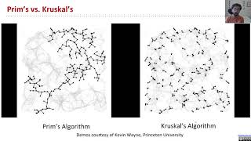
Prim’s vs. Kruskal’s (visual)
Demos courtesy of Kevin Wayne, Princeton University

Slide 105
Kruskal's Algorithm Code and Runtime
Graph Problem Warmup
Minimum Spanning Trees
Intro
The Cut Property
Prim’s Algorithm
Basic Prim's (Demo)
Optimized Prim's (Demo)
Prim’s Algorithm Code and Runtime
Kruskal’s Algorithm:
Basic Kruskal’s (Demo)
Optimized Kruskal’s (Demo)
Kruskal's vs. Prim's
Kruskal's Algorithm Code and Runtime
Lecture 25, CS61B, Fall 2023

Slide 106
Kruskal’s Implementation (Pseudocode)
What is the runtime of Kruskal’s algorithm?
Assume all PQ operations take O(log(V)) time.
Assume all WQU operations take O(log* V) time.
Give your answer in Big O notation.
public class KruskalMST {
private List<Edge> mst = new ArrayList<Edge>();
public KruskalMST(EdgeWeightedGraph G) {
MinPQ<Edge> pq = new MinPQ<Edge>();
for (Edge e : G.edges()) {
pq.insert(e);
}
WeightedQuickUnionPC uf =
new WeightedQuickUnionPC(G.V());
while (!pq.isEmpty() && mst.size() < G.V() - 1) {
Edge e = pq.delMin();
int v = e.from();
int w = e.to();
if (!uf.connected(v, w)) {
uf.union(v, w);
mst.add(e);
} } } }

Slide 107
Kruskal’s Runtime
Kruskal’s algorithm on previous slide is O(E log E).
Note 1: If we use a pre-sorted list of edges (instead of a PQ), then we can simply iterate through the list in O(E) time, so overall runtime is O(E + V log* V + E log* V) = O(E log* V).
Note 2: E < V², so log E < log V² = 2 log V, so O(E log E) = O(E log V). So while Kruskal's algorithm will be slower than Prim's algorithm for a worst-case unsorted set of edges, it won't be asymptotically slower.
Fun fact: In HeapSort lecture, we will discuss how do this step in O(E) time using “bottom-up heapification”.
Operation | Number of Times | Time per Operation | Total Time
Insert | E | O(log E) | O(E log E)
Delete minimum | O(E) | O(log E) | O(E log E)
union | O(V) | O(log* V) | O(V log* V)
isConnected | O(E) | O(log* V) | O(E log* V)

Slide 108
Shortest Paths and MST Algorithms Summary
Problem | Algorithm | Runtime (if E > V) | Notes
Shortest Paths | Dijkstra’s | O(E log V) | Fails for negative weight edges.
MST | Prim’s | O(E log V) | Analogous to Dijkstra’s.
MST | Kruskal’s | O(E log E) | Uses WQUPC.
MST | Kruskal’s with pre-sorted edges | O(E log* V) | Uses WQUPC.
Question: Can we do better than O(E log V)? See bonus slides.

Slide 109
Extra: MST Algorithm History
These slides are covered in the web videos, but we won't cover them live.
Graph Problem Warmup
Minimum Spanning Trees
Intro
The Cut Property
Prim’s Algorithm
Basic Prim's (Demo)
Optimized Prim's (Demo)
Prim’s Algorithm Code and Runtime
Kruskal’s Algorithm:
Basic Kruskal’s (Demo)
Optimized Kruskal’s (Demo)
Kruskal's vs. Prim's
Kruskal's Algorithm Code and Runtime
Lecture 25, CS61B, Fall 2023

Slide 110
170 Spoiler: State of the Art Compare-Based MST Algorithms
year | worst case | discovered by
1975 | E log log V | Yao
1984 | E log* V | Fredman-Tarjan
1986 | E log (log* V) | Gabow-Galil-Spencer-Tarjan
1997 | E α(V) log α(V) | Chazelle
2000 | E α(V) | Chazelle
2002 | optimal (link) | Pettie-Ramachandran
??? | E ??? | ???
(Slide Courtesy of Kevin Wayne, Princeton University)

